Slide 1
Non-Invasive Ventilator Mask for COVID-19 3D Printing
March 31, 2020

Slide 2
Requirements
Mask needs to cover all mucus membranes above the neck (eyes, nose, mouth)
Must be sealed and all exhausted air needs to be filtered (N95 or greater)
Needs to be cleanable; Autoclave sterilization is not a requirement
CO2 needs measured in exhaust before filter
Exhaust needs fed back to machine after filter for ventilator design by to atmosphere for CPAP/BiPAP design
Port for administering nebulized meds is desirable
Hot swap of filters

Slide 3
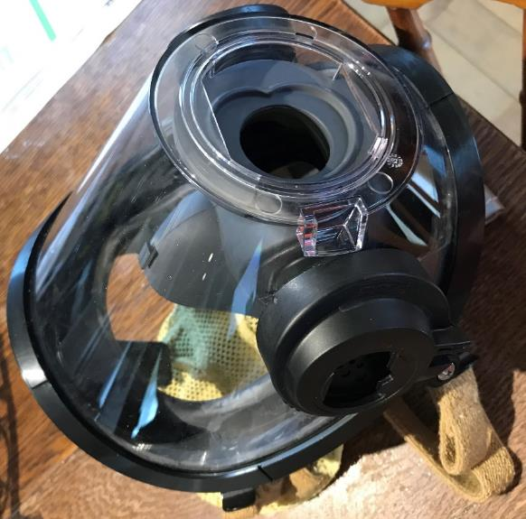
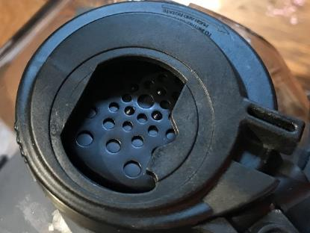
Scott AV 3000 Series
Primary product used by North American Fire Fighters
Redundant sealing around mouth & nose and around face
Simple universal I/O port with redundant sealing
Comes in 3 different sizes to ensure a good fit; 5 pt head harness
Can be fit with a comms adapter to allow better patient-provider communication
6 week lead time
~$385 (Kevlar) or $290 (Polyester) USD list price

Slide 4
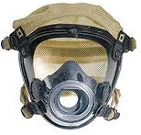
Scott AV 2000 Series
Primary product used by North American Fire Fighters
Single sealing around mouth, nose and around face
Simple universal I/O port with redundant sealing
Comes in 3 different sizes to ensure a good fit; 4pt head harness
Can be fit with a comms adapter to allow better patient-provider communication
1 week lead time
~$385 (Kevlar) or $290 (Polyester) USD list price

Slide 5
Adapter interface

Slide 6
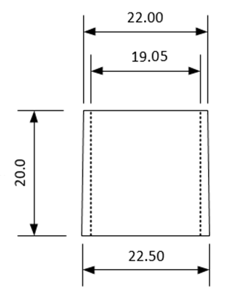
22 mm Inlet Adapter
Standard interface for ventilator/CPAP/BiPAP equipment
Friction fit of the connecting hose on the tapered male tube interface
Hose Side
Equipment Side

Slide 7
Functional Interface Diagram - Mask
ears
eyes
mouth
nose
Scott AV3000 or AV2000 mask
From CPAP/BIPAP
22mm ISO 5356-1
Male
To CPAP/BIPAP
22mm ISO 5356-1
Male
>= N95 Filter
Up to 60 l/min
Preferable to find way to combine most into a standard interface with adapters

Slide 8
Ventilator/CPAP/BiPAP Adapter for AV2000 or AV3000

Slide 9
Adapter 3D Print Requirements
Printed in ABS or PETG
Initial qty of 100 (London coverage)
Qty up to 1000 (Ontario coverage)

Slide 10
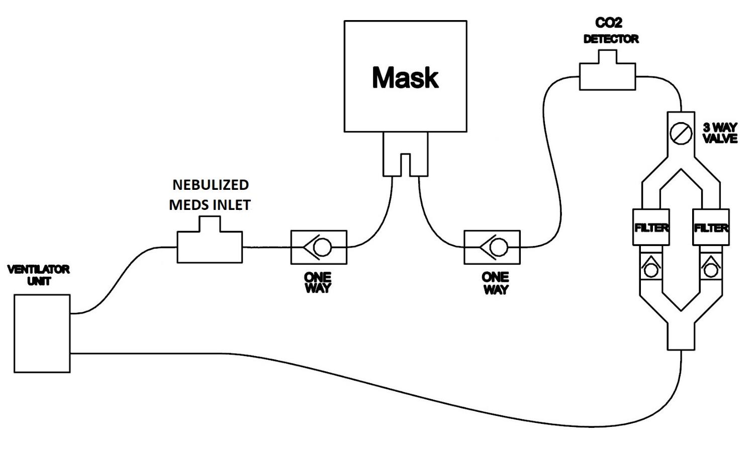
Functional System Diagram – Ventilator

Slide 11
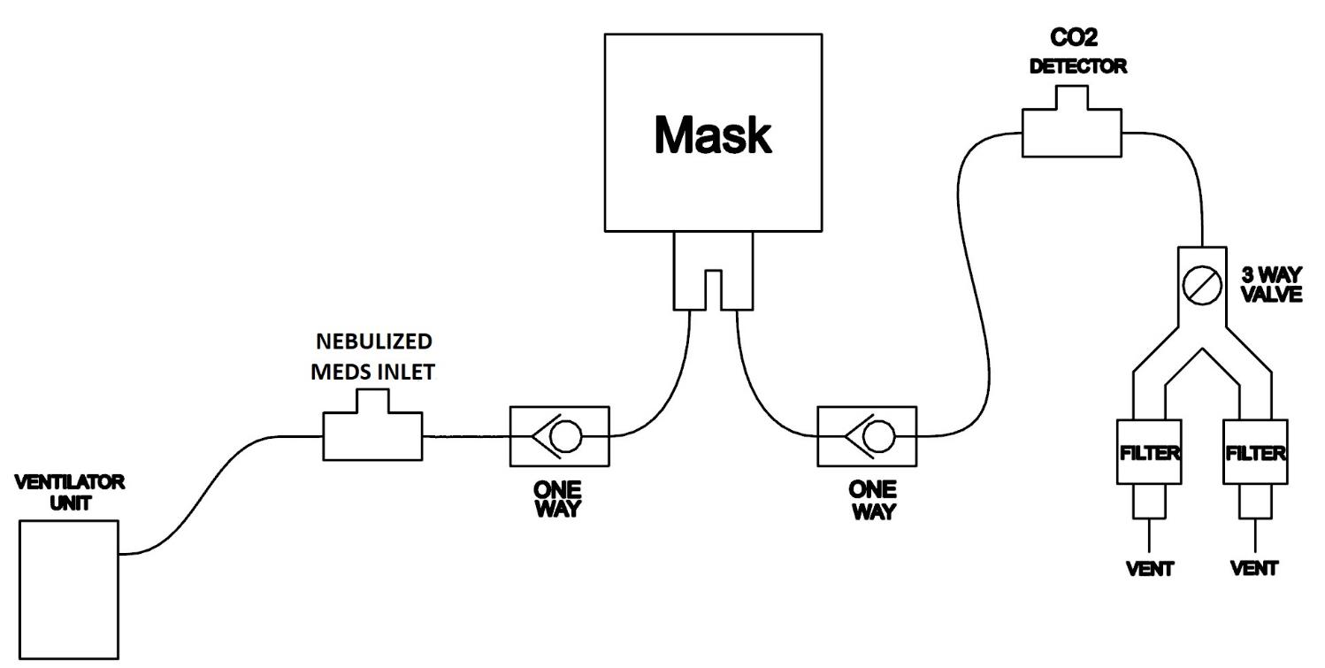
Functional System Diagram – CPAP/BiPAP

Slide 12
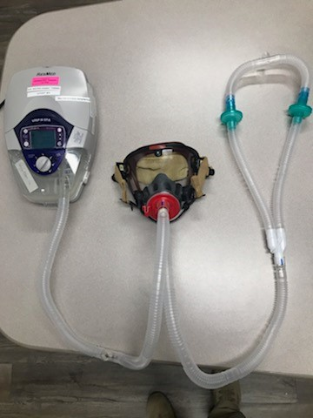
System Layout – CPAP/BiPAP

Slide 13
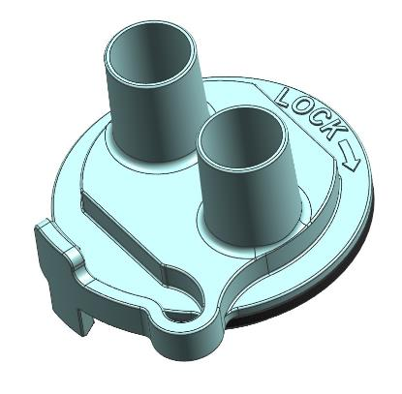
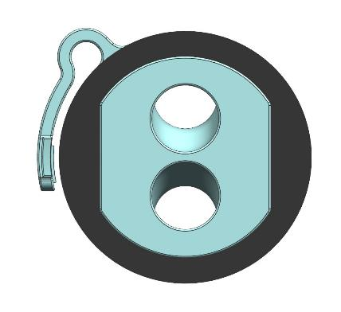
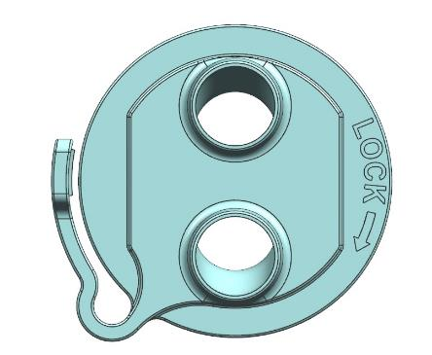
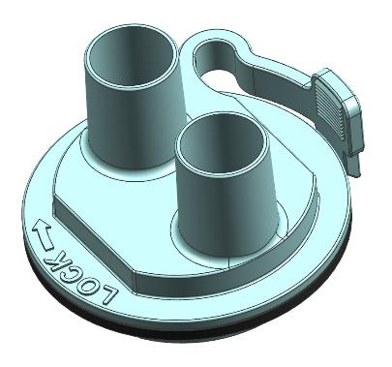
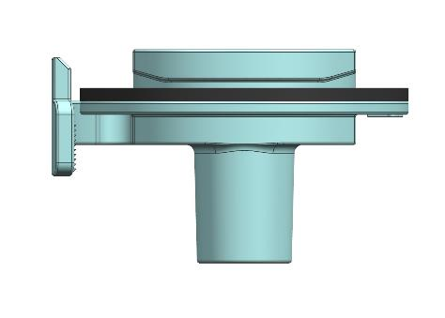
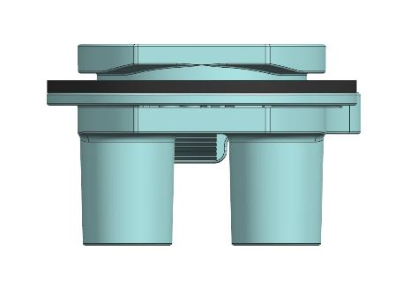
Adapter R5 - Model
Design incorporates 3D printing DFM analysis, minimized part count, HFE improved latch, and optimization for printing in multiple materials (PETG, ABS)

Slide 14
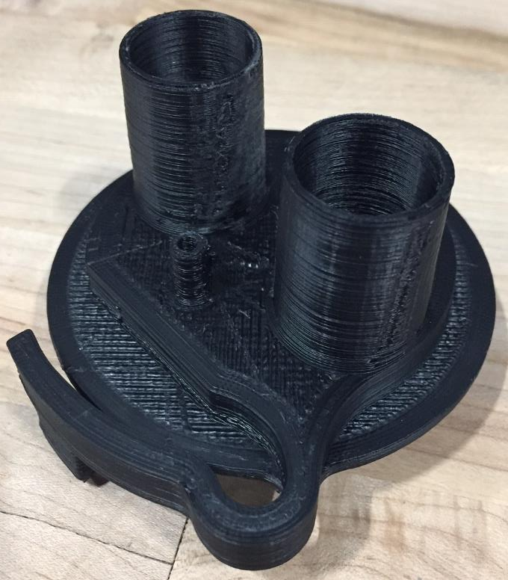
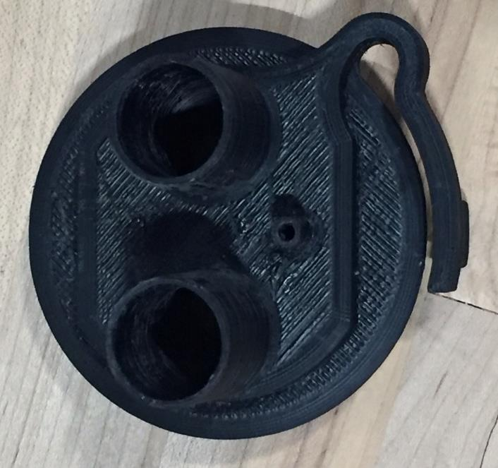
Adapter R4 – First ABS Print

Slide 15
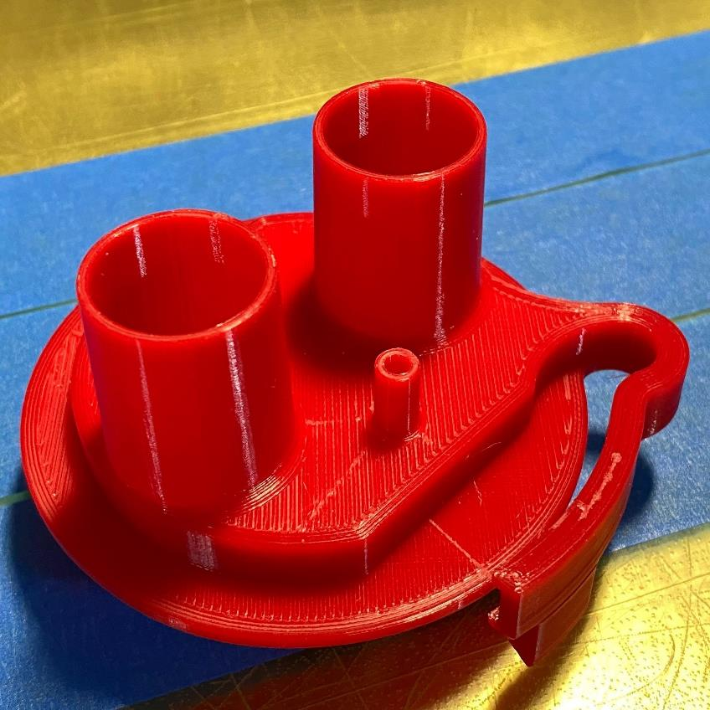
Adapter R4 – First PETG Print

Slide 16
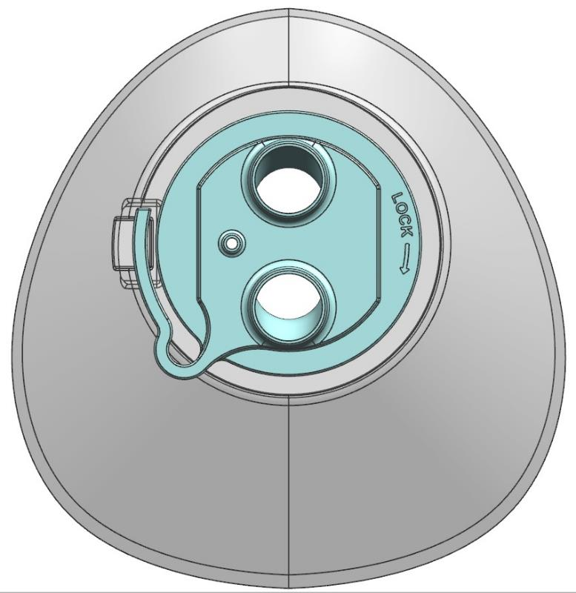
Adapter 4 – Model Fit-up

Slide 17
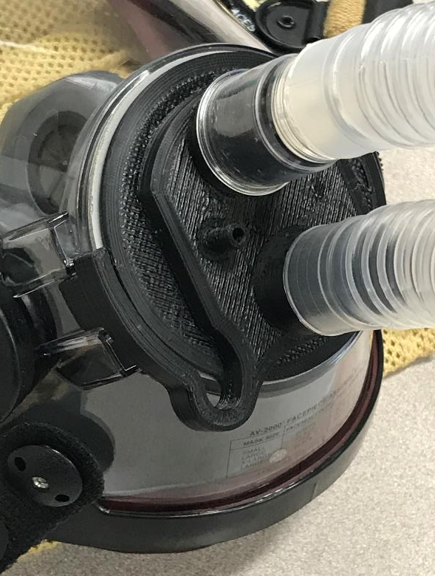
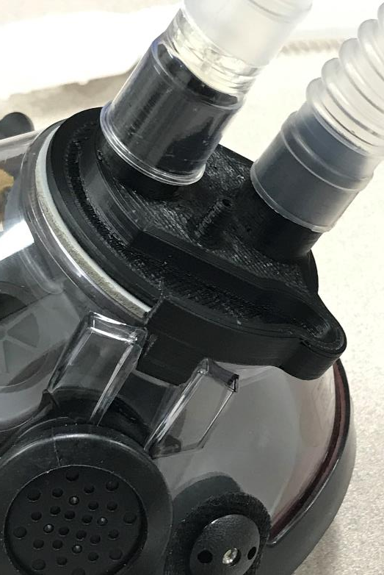
Fit to Mask

Slide 18
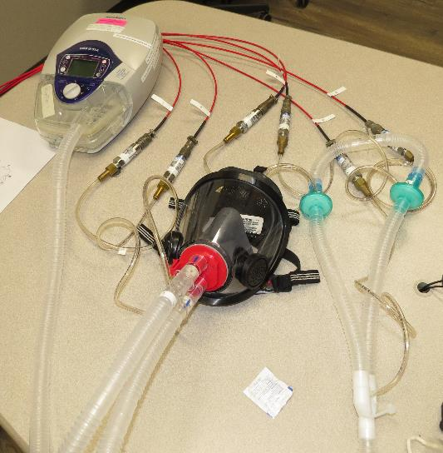
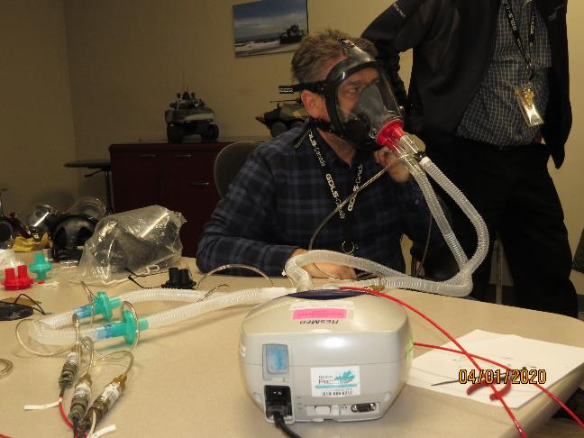
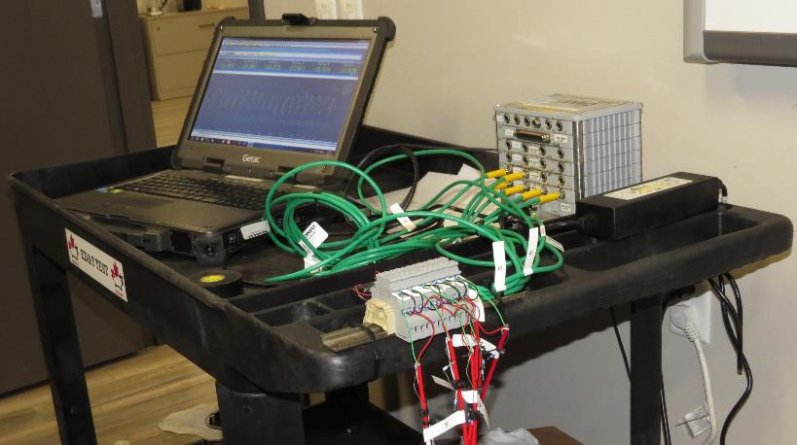
Test Setup Photos
IPAP = 20 cm H₂O
EPAP = 5.0 cm H₂O
BPM = 12
Ti = 1.0 sec

Slide 19
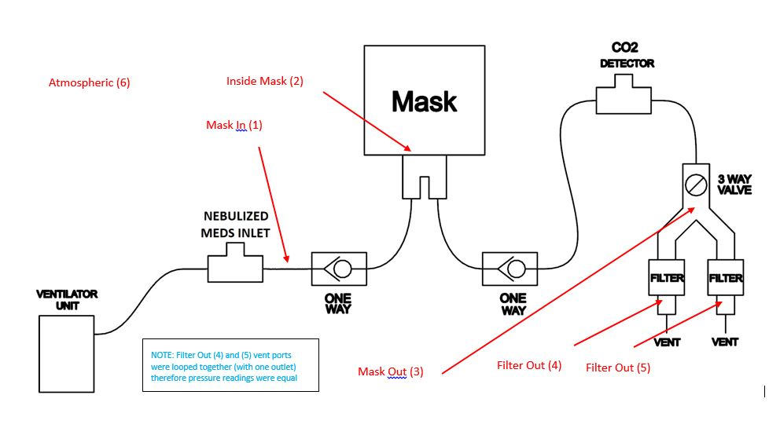
Test Pressure Transducer Locations

Slide 20
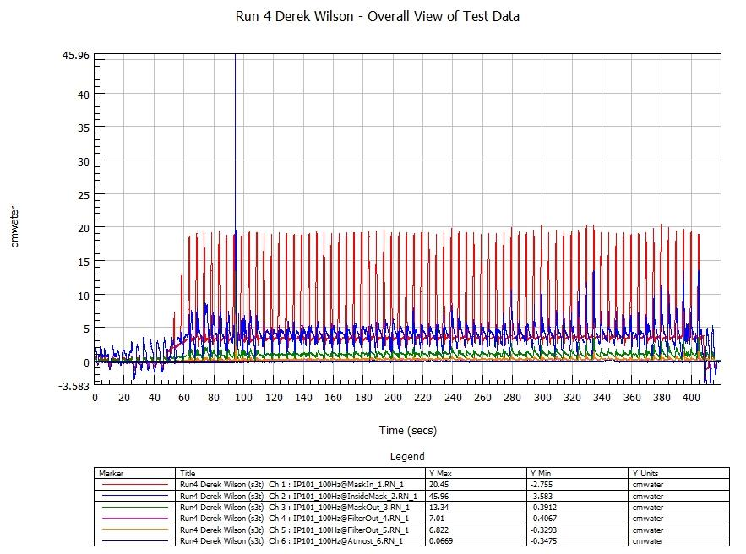
Test Results - Overview

Slide 21
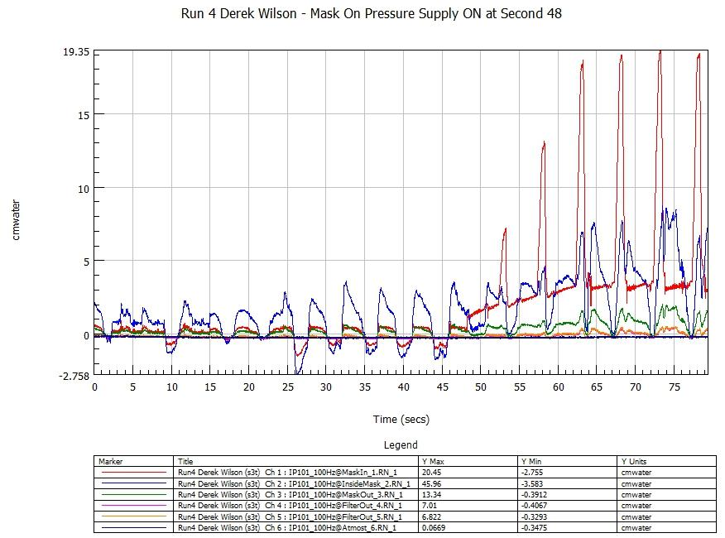
Test Results – BiPAP Ramp Up

Slide 22
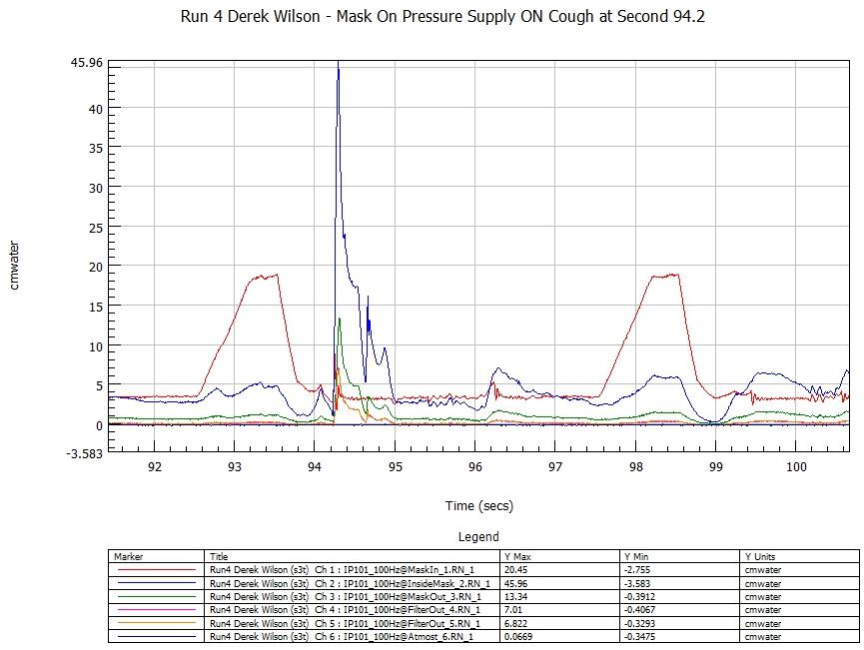
Test Results – Cough Pressure Spike

Slide 23
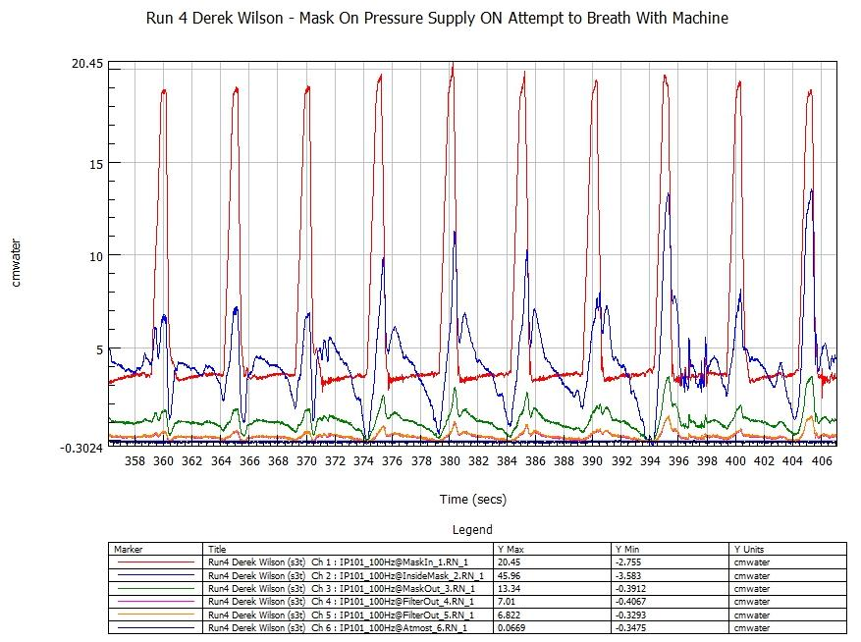
Test Results - Breathing Out of Sync

Slide 24
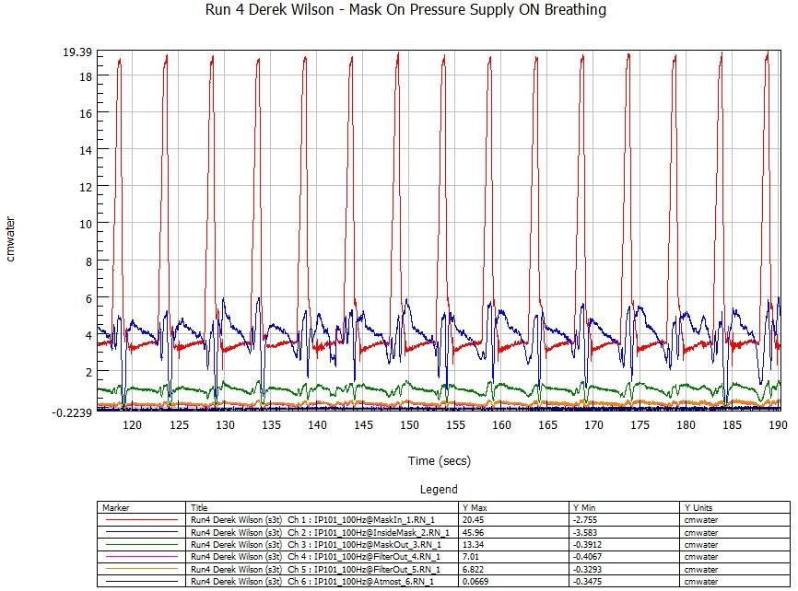
Test Results - Breathing in Sync

Slide 25
Test Comments
Large AV3000 mask used
RESMED VPAP III ST-A used
11 days beard growth on test subject
No discernable leakage between mask and face for majority of test
Cough pressure spike did cause a momentary leak between seal and face
There were no leakage alarms during test

Slide 26
Backup

Slide 27
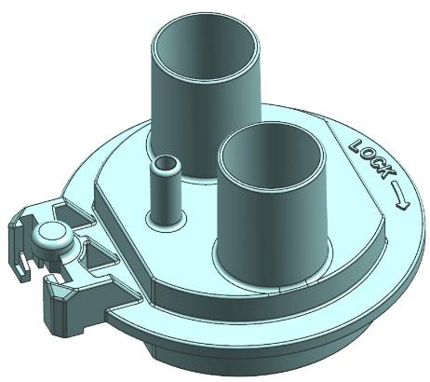
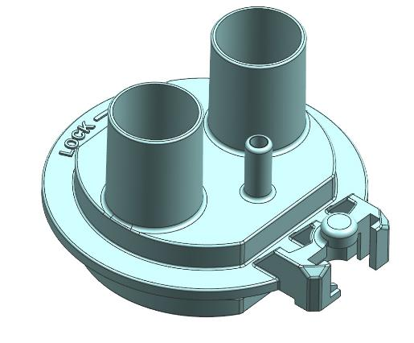
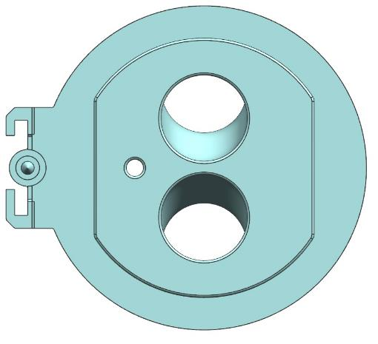
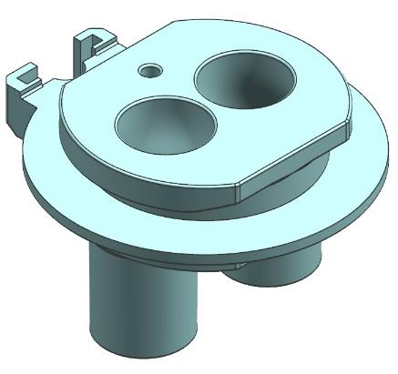
Adapter R1 - Model

Slide 28
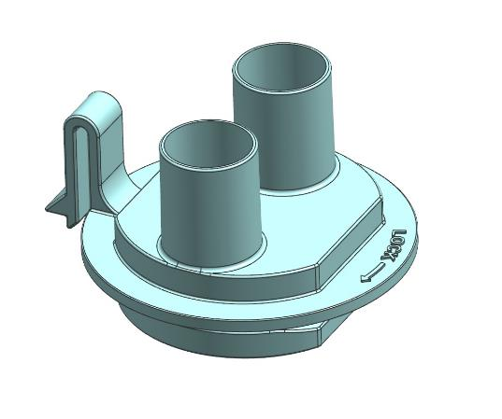
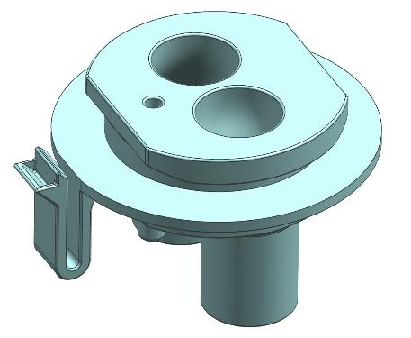
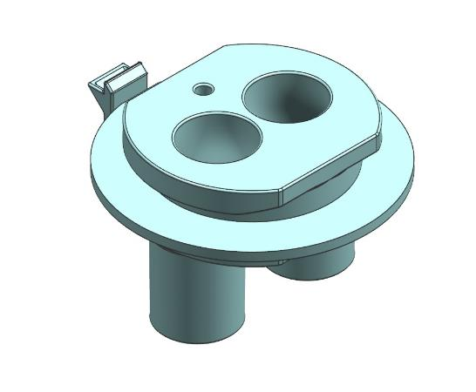
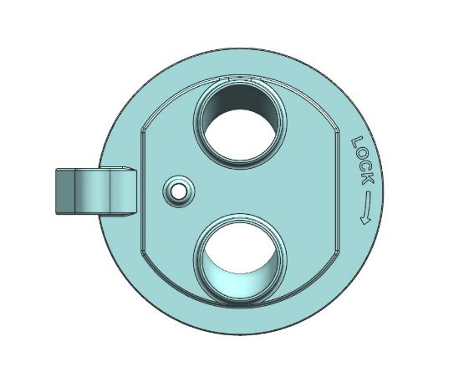
Adapter R2 - Model

Slide 29
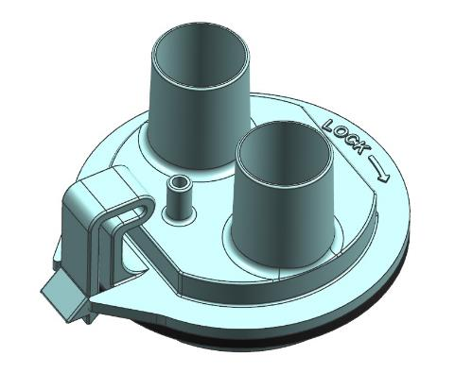
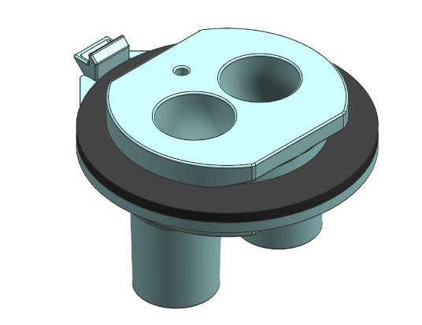
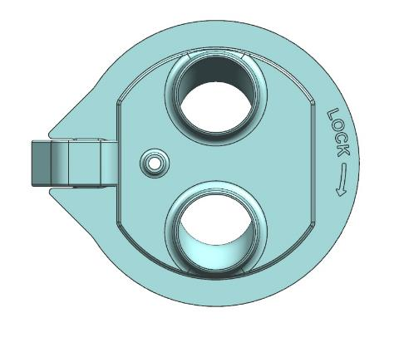
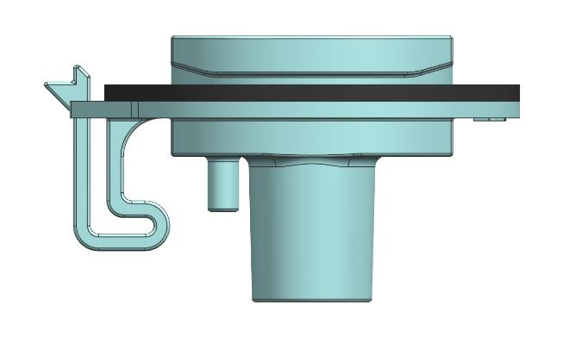
Adapter R3
Modelled but not printed or fitted-up.

Slide 30
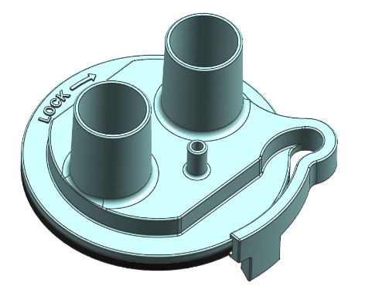
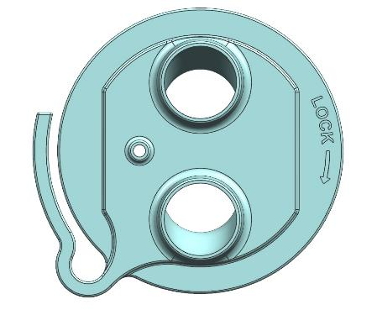
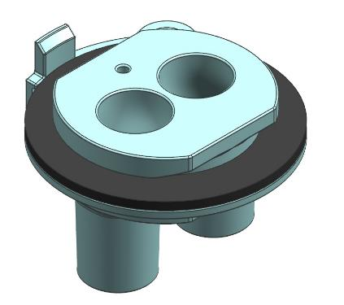
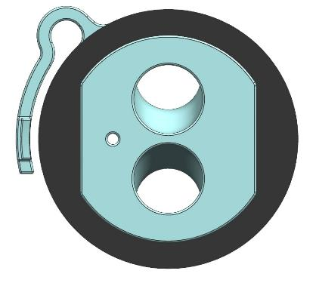
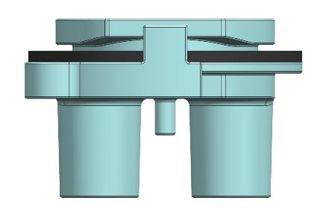
Adapter R4

Slide 31
Confirmed Assumptions
Mask needs to cover all mucus membranes above the neck (eyes, nose, mouth) – Ears not required
The patient will receive nutrition intravenously, if required
All vital signs will be monitored in methods that do not interfere with the function of the mask or its ability to seal against the patients skin
PIP and PEEP functions will be accomplished by the ventilator unit, and not the mask
Autoclave sterilization is not a requirement

